Slide 1
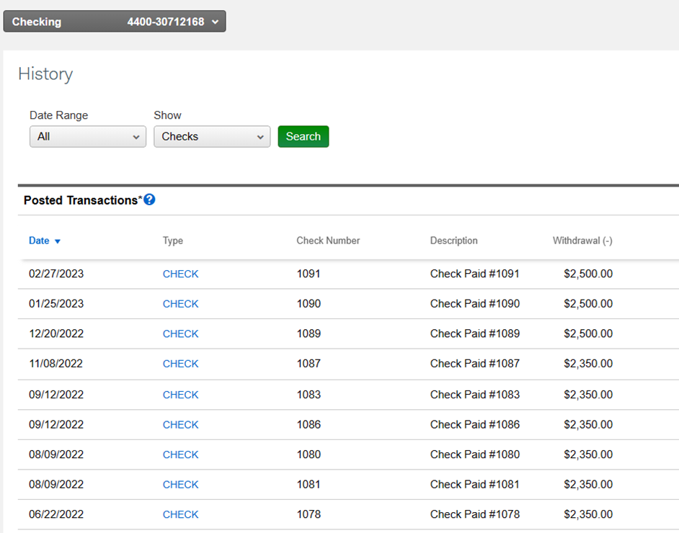
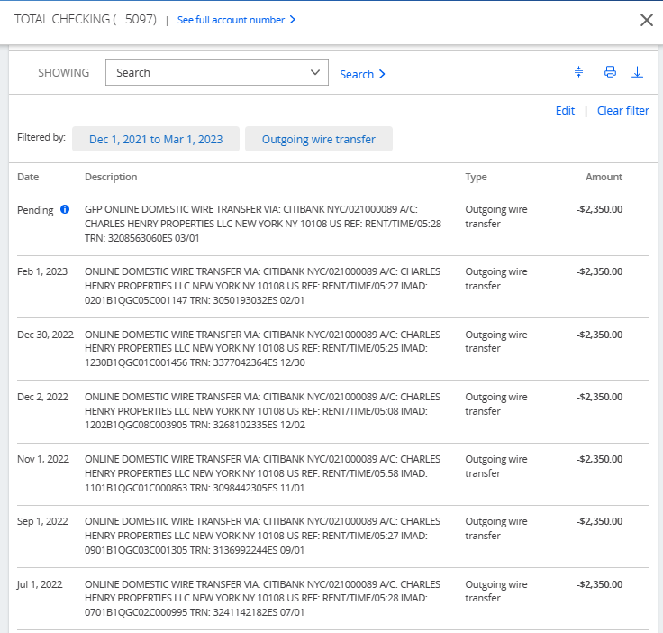
Double paid 7 months in red
March is partially paid from wire at old rate
Of $2350 and owe $150 to be sent via check
But owe $150 to new rate of $2,500
-----------------------------------
Chase Account Auto Pay
Charles Schwab Checks
=
March
Feb
Feb
Jan
Jan
Dec
Dec
Nov
Oct
Nov
Sept
Sept
Aug
Aug
July
July

Slide 2
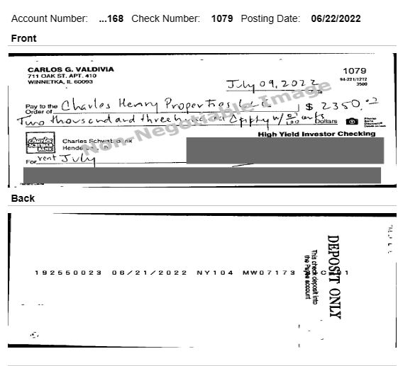
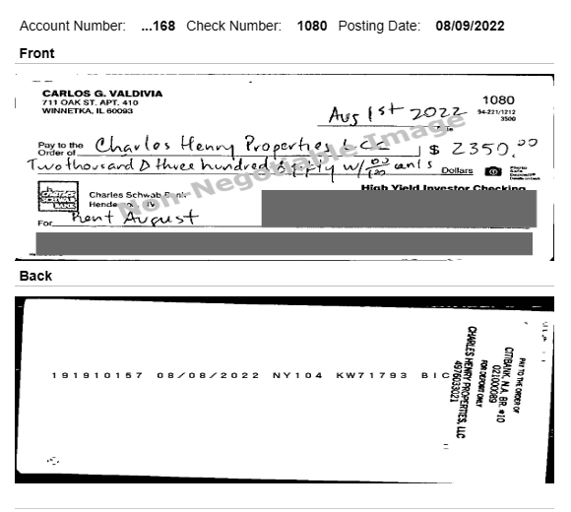
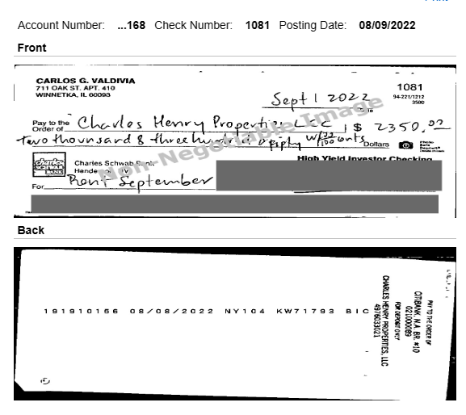
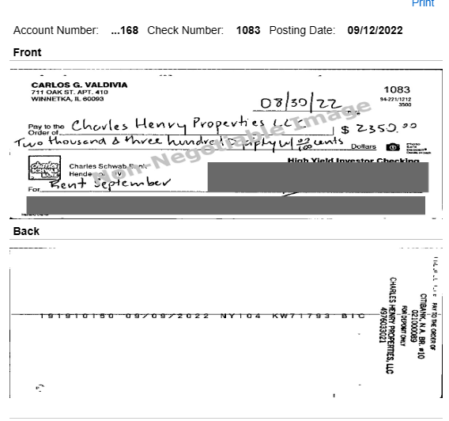
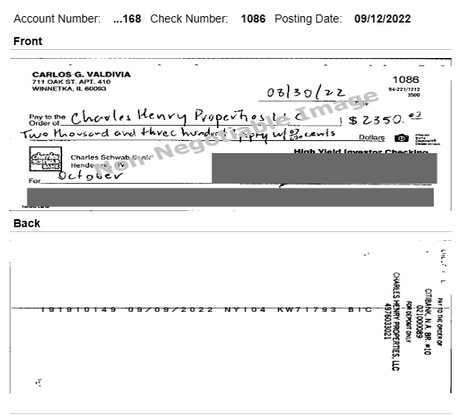
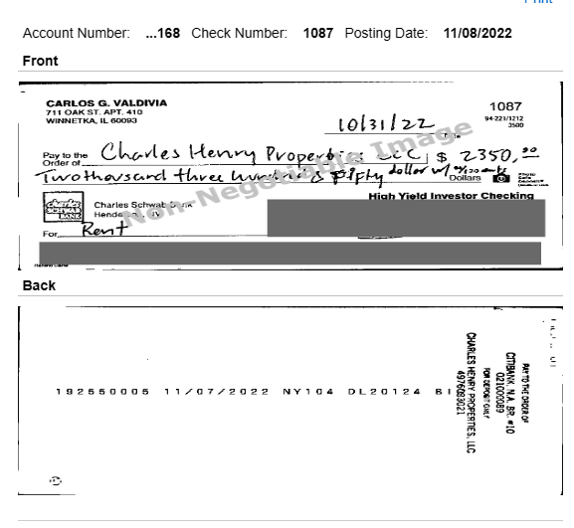
July Rent
Aug Rent
September Rent
November Rent

Slide 3
